Slide 1


#5 Deep Learning
by Saturdays.AI
Saturdays.AI Madrid
Machine Learning

Slide 2

Week 5
Schedule
State of the course
Session 5 Review
Challenge
Notebook + resources

Slide 3
Sesión 5
Agenda
01:30 - Lesson #5 + Work!
03:30 - Coffee Break ☕️
03: 45 - Keep Working! 🚀
05:00 - Talk! 🗣

Slide 4
State of the course
#1 Exploratory Data Analysis & Classification ✅
#2 Regression & Model Validation ✅
#3 Random Forest Deep Dive ✅
#4 Unsupervised Learning ✅
#5 Neural Networks, Gradient Descent 🔴 Today!
#6 NLP 🔜

Slide 5

¿Doubts?

Slide 6
Neural Networks
Deep Learning
Gradient Descent
Backpropagation
Activation functions
Keras & Your first NN!

Slide 7
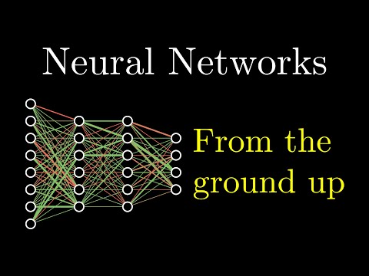
Deep Learning

Slide 8
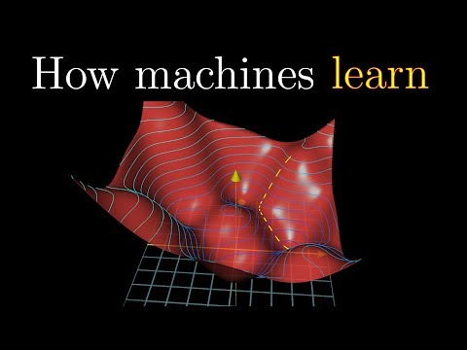
Gradient Descent

Slide 9
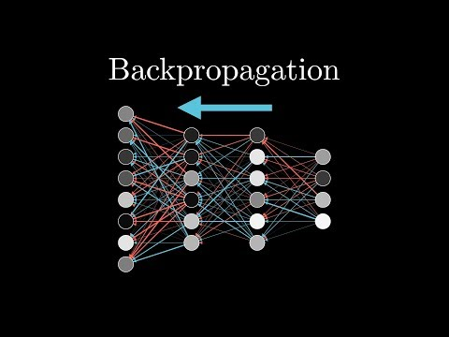
Backpropagation

Slide 10
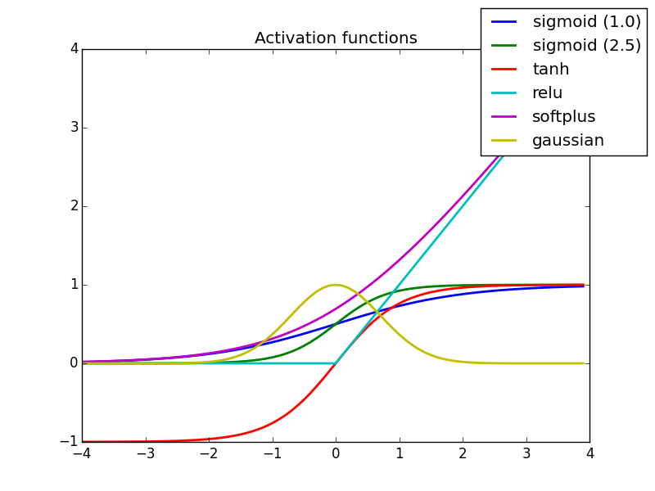
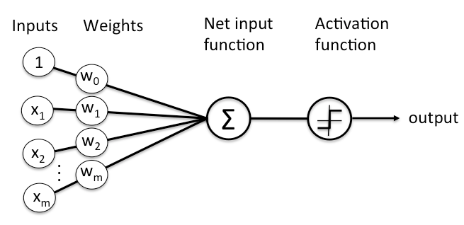
Content Review: Neuron

Slide 11
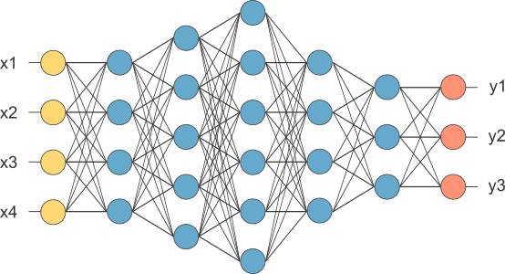
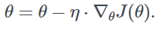
Content Review: Network
How are weights learned?
>>> Optimizers!!

Slide 12
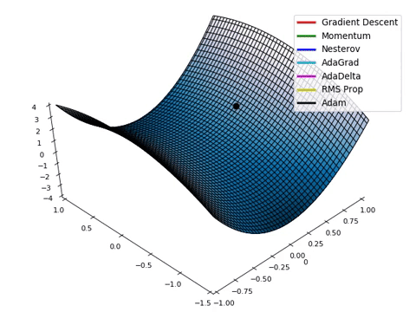

Extra Content: Optimizers

Slide 13
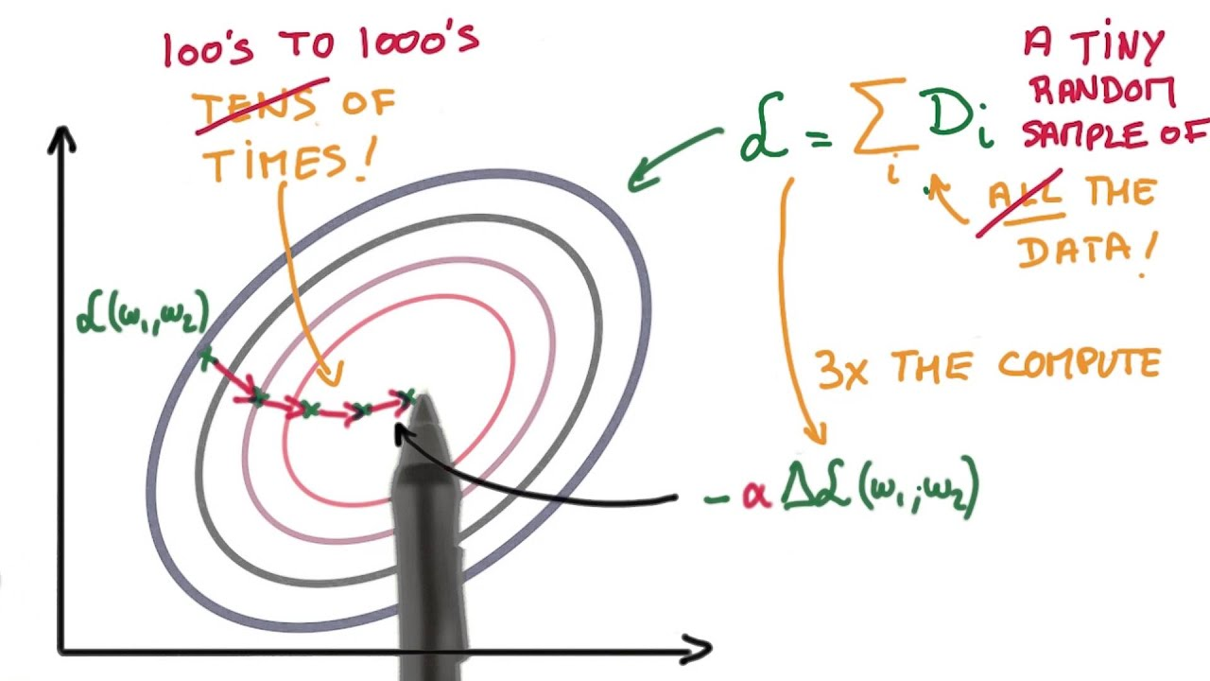
SGD
NEURAL NETWORK USING STOCHASTIC GRADIENT DESCENT

Slide 14
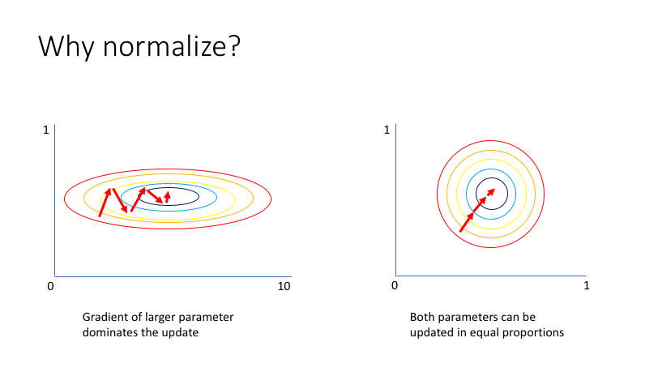
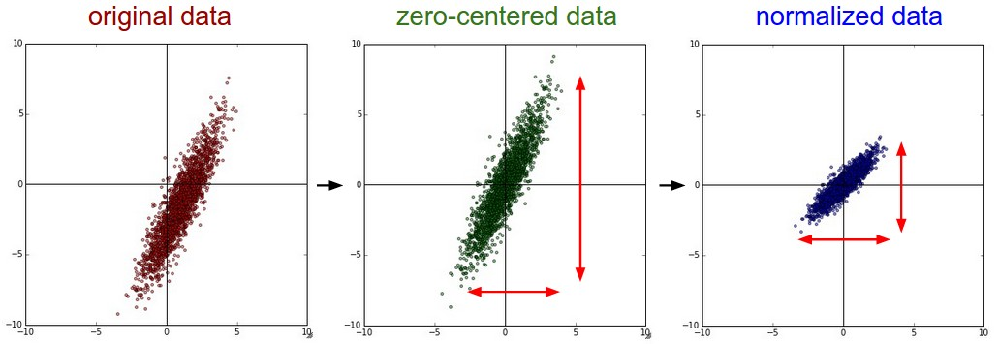
SGD

Slide 15
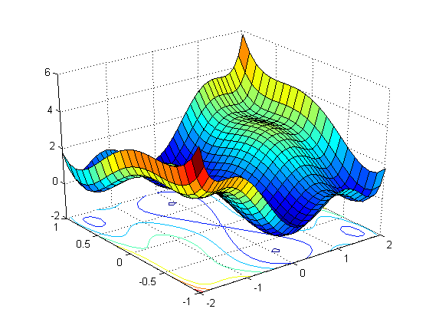
Loss Function

Slide 16
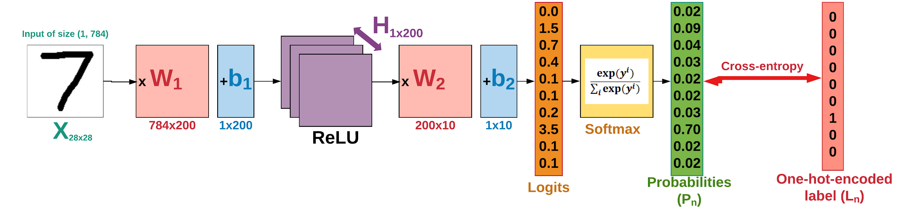
Pipeline & Argmax

Slide 17

Learning Rates
Understand the Impact of Learning Rate on Neural Network Performance

Slide 18

Why Keras?
Keras vs Pytorch for Deep Learning

Slide 19
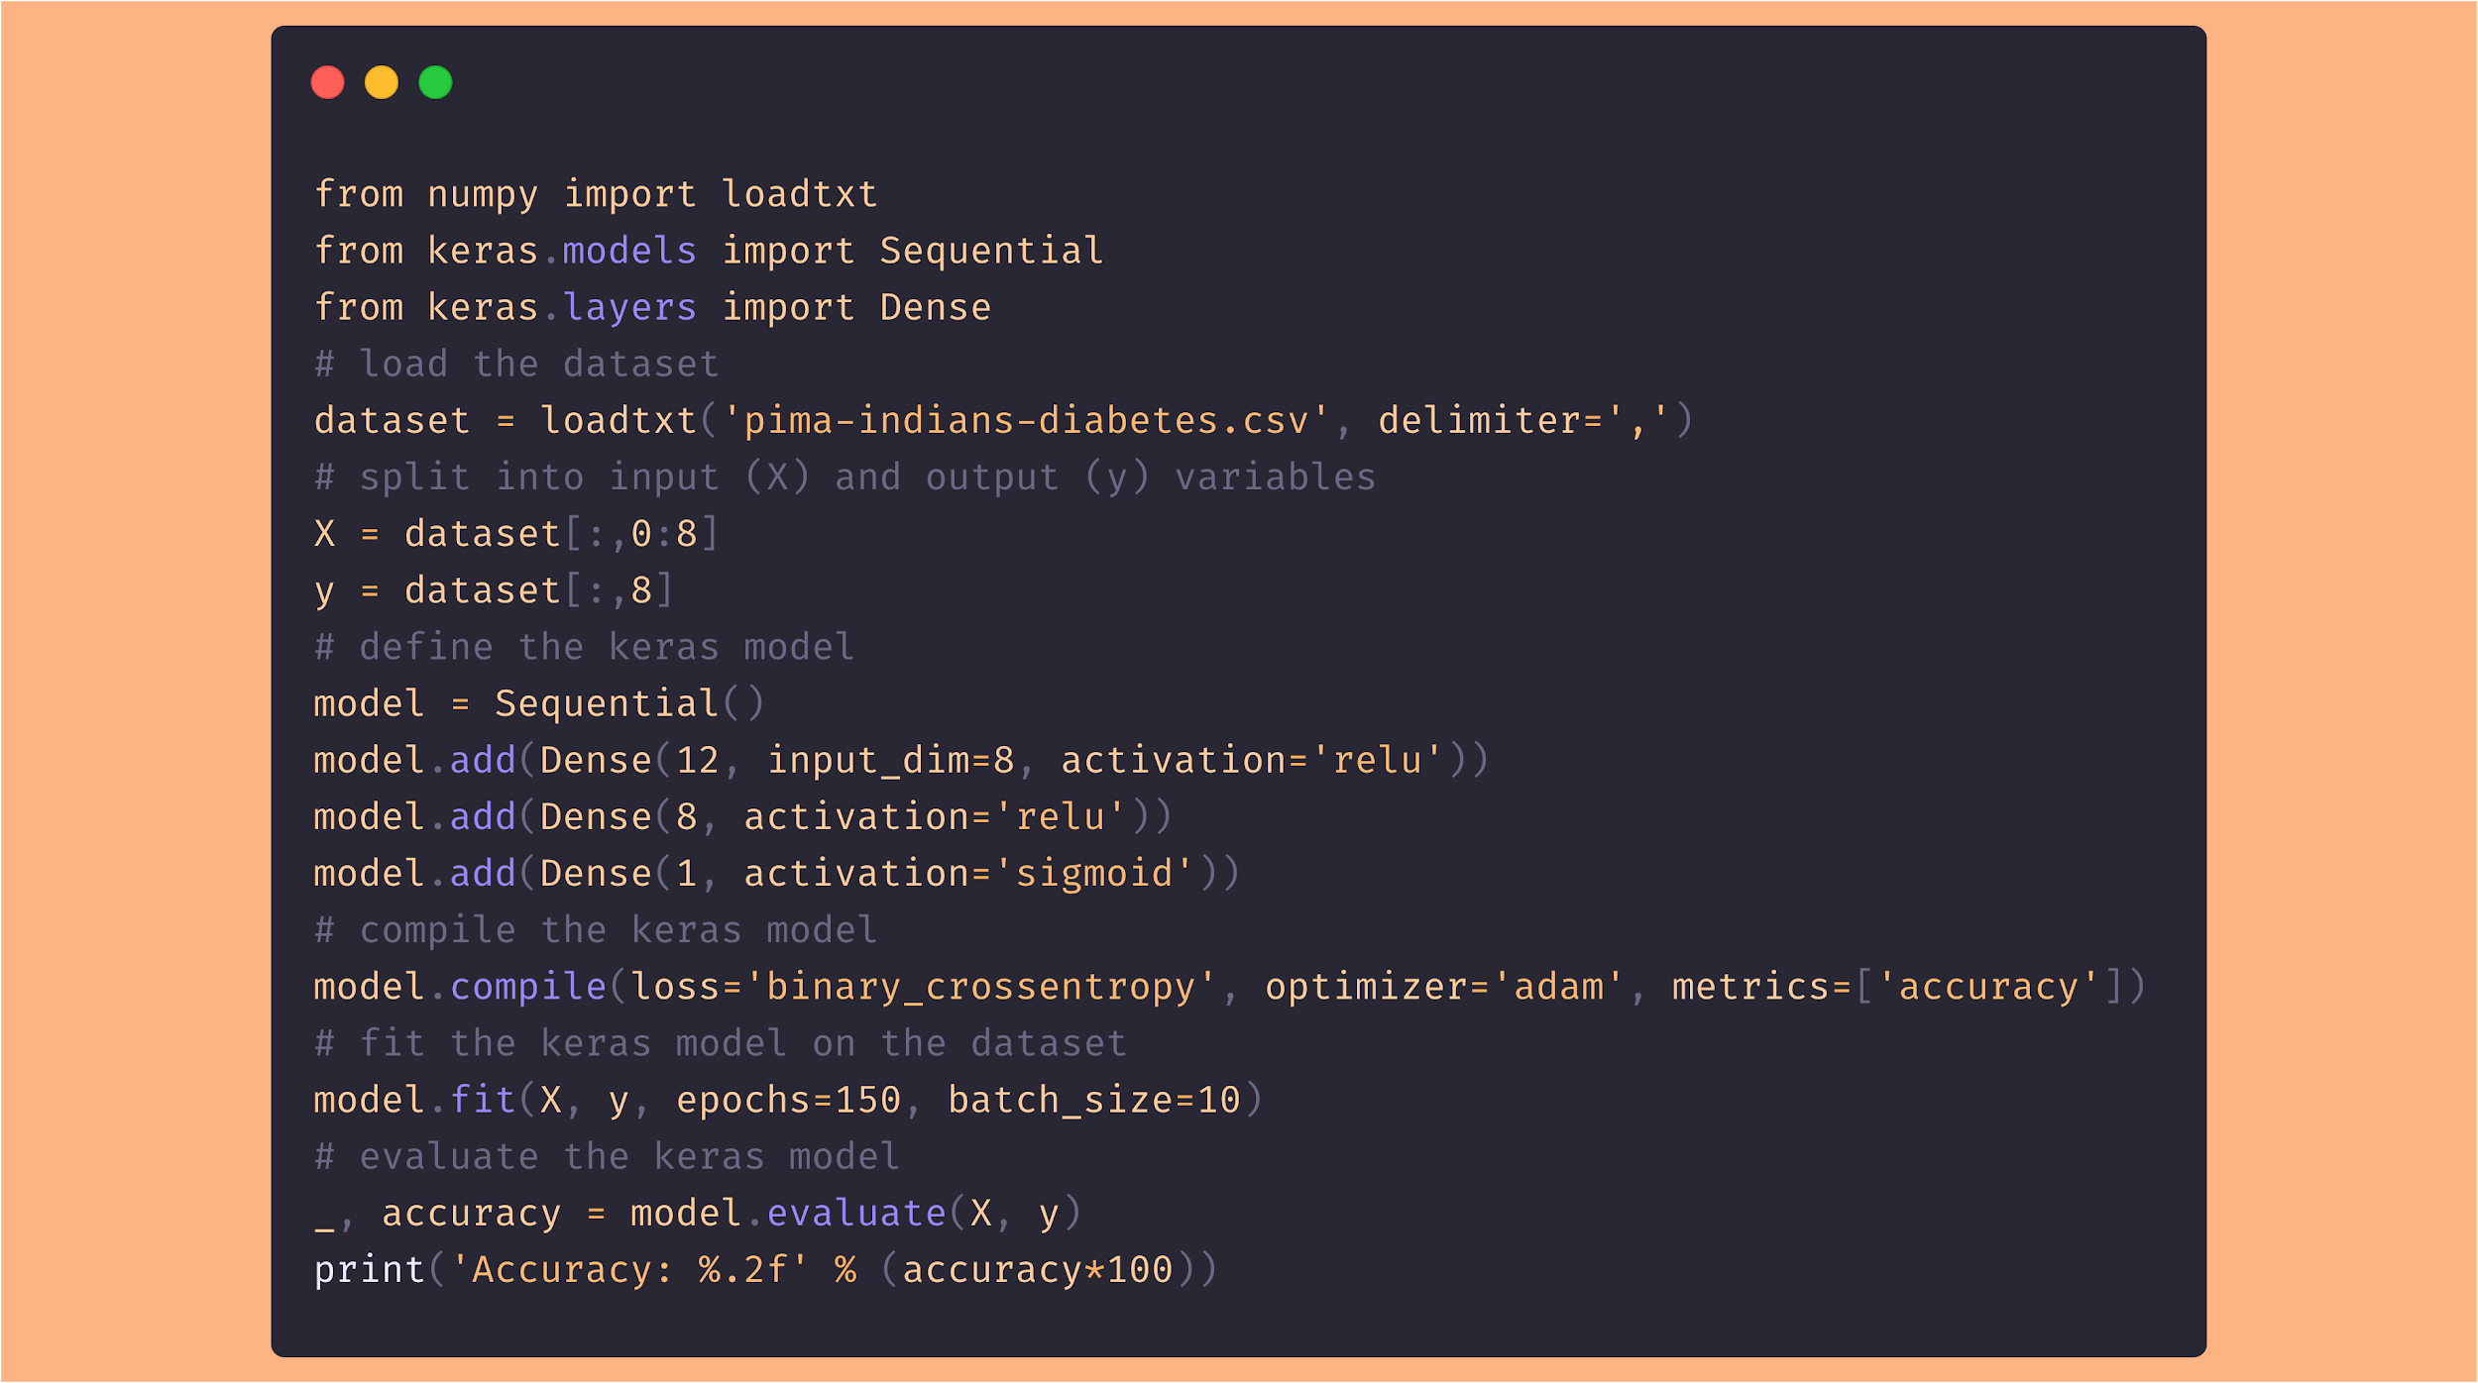
Keras Model
Click on the image

Slide 20

Challenge!

Slide 21
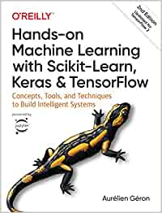


Bibliografía
/1./ /Hands-on Machine Learning with Scikit-Learn, Keras, and TensorFlow/
/2./ /Fast.AI - Introduction to Machine Learning for Coders/
/3./ /MLCourse.AI/
/4./ /DeltaAnalytics/
/5./ /The Hundred-page Machine Learning Book/
/6./ /Machine Learning for Humans (Vishal Maini)/
/7./ /Datacamp/
/8./ /DataQuest/

Slide 22

WI-FI
Wi-Fi
madrid@saturdays.ai

